Slide 1
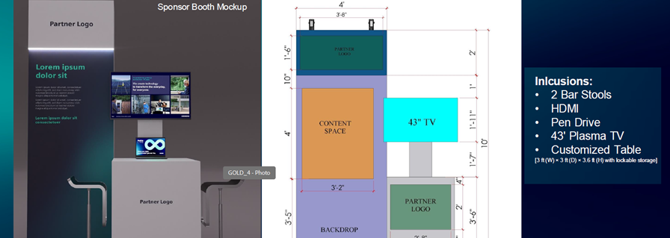
REALIZE LIVE – Knowledge SESSION
Bridging Shopfloor Reality and MES Performance

Slide 2
GENERAL GUIDELINES
Focus on knowledge sharing, not product promotion.
Keep content concise and event friendly.
Avoid text heavy slides.
Follow the storyline: Problem => Insight => Approach => Impact.
Only the Heading, Subheading, and Bullet Points (not the description) are intended to appear on the final slide. All other sections (Slide Objective, Key Message, Context / Speaker Reference, Visual Intent, and Speaker Notes) are meant for internal alignment, content development, and design guidance.
Design, animation, and visual storytelling will be developed separately by the design team

Slide 3
SLIDE STRUCTURE – APPLICABLE TO ALL SLIDES
1. Slide Objective: Purpose of the slide and why it exists in the overall narrative.
2. Key Message: The single most important takeaway the audience should remember from the slide.
3. Heading: Short and impactful slide title.
4. Subheading : Supporting statement to reinforce the heading.
5. Bullets (3–5 Maximum)
Keep bullets short and impactful.
Use phrases, not long sentences.
The speaker will elaborate during the presentation.
Focus on key messages rather than detailed explanations.
6. Context / Speaker Reference: Brief explanation behind each bullet to help the speaker understand the intended message and talking points.
7. Visual Intent: Description of the visual concept that should support the slide (diagram, workflow, architecture, animation, infographic, etc.).
8. Speaker Notes / Narrative Intent: Explaining how the slide contributes to the overall story and connects to the next slide.

Slide 4
USE CASE – MANUFACTURING ANALYTICS
Slide Objective:
Key Message:
CONTENT:
Problem:
bullets
Approach
Bullets
Imapct
bullets

Slide 5
VISUAL INTENT AND SPEAKER NOTES FOR SLIDE 7
Speaker Notes / Narrative Intent

Slide 6
THE Real GAP
Slide Objective: Challenge the common assumption that MES itself is responsible for inconsistent outcomes and introduce execution readiness as the real differentiator
Key Message: The gap is not MES capability, but plant and execution readiness
Subheading : Why Similar MES Programs Deliver Different Outcomes. Bullets:
MES Relies on Operational Inputs or Data Flows from Shopfloor: MES effectiveness depends on the quality, consistency, and timeliness of operational data received from the shopfloor
OT Readiness Varies Across Plants: Manufacturing environments differ significantly in terms of connectivity, automation maturity, and data availability
Inconsistent Machine Connectivity: Not all assets are connected equally, leading to gaps in data collection and system visibility
Manual Processes Still Persist: Critical production information often continues to rely on manual entry, operator intervention, or offline records
Limited Focus on Execution Design / Absence of Design Thinking Approach: MES programs often emphasize software deployment while underestimating shopfloor studies, operational workflows, and execution readiness

Slide 7
VISUAL INTENT AND SPEAKER NOTES FOR SLIDE 3
Visual Intent Show MES sitting above the shopfloor, with uneven data flows coming from different production assets.
The visual should convey that:
MES is ready.
The operational environment beneath it is inconsistent.
The challenge lies in the foundation, not the application layer
Speaker Notes / Narrative Intent This slide shifts the conversation from technology to execution.
The audience should begin to realize:
Two plants may deploy the same MES platform yet achieve very different outcomes because the operational conditions underneath are different. The objective is to challenge the assumption that MES success is determined solely by software capability and prepare the audience for the deeper operational realities discussed in Slide 4 and Slide 5

